Slide 1

Reducing barriers to physicians receiving mental health care
[Your name]
In collaboration with the
Helping Healthcare Heal Coalition
Notes:
This is a presentation on why and how we can reduce barriers to physicians receiving mental health care. These slides were developed as part of the Helping Healthcare Heal Coalition of the Institute for Healthcare Improvement
You’ll notice many QR codes that link the articles discussed. Please feel free to point your smartphone camera at them so you can pull up the article and read it in the future.

Slide 2
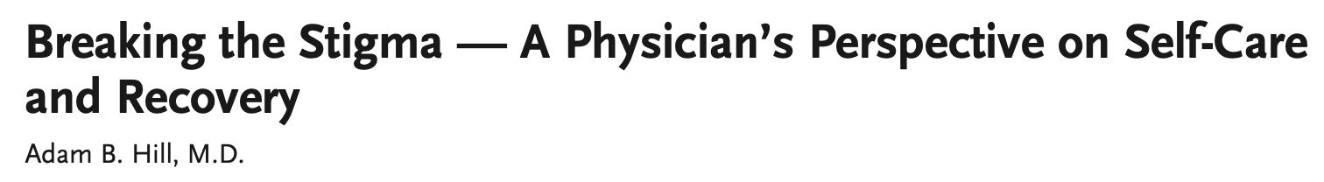

A story
Notes:
But first we will start with a story, to illustrate why this topic is so important.
(Please feel welcome to provide copies of this NEJM article and give the audience time to read it, or to share a story about someone affected by applications asking about mental health and how it deterred help-seeking)

Slide 3


A story
Notes:
Or feel welcome to show this 6 minute video. (You will have to imbed the video in your PPT or open it in a separate window to show it.)
Website:
https://www.acpjournals.org/doi/10.7326/W19-0001

Slide 4
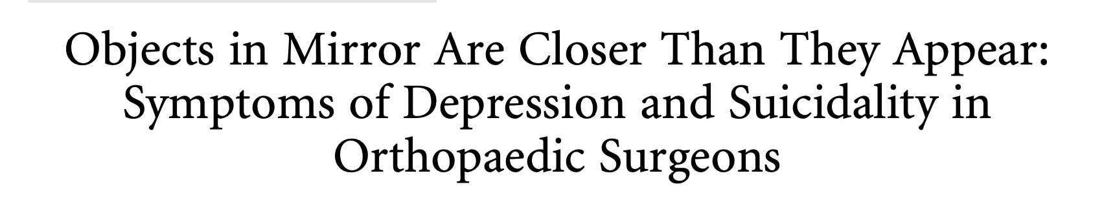
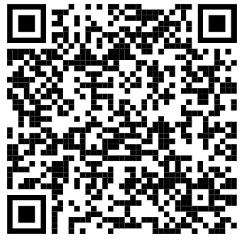
Physicians are under a great deal of strain
Notes:
This paper was published in 2022 in a prominent Orthopedics journal. The findings highlight how much strain physicians are under, including experiencing suicidal thoughts.

Slide 5
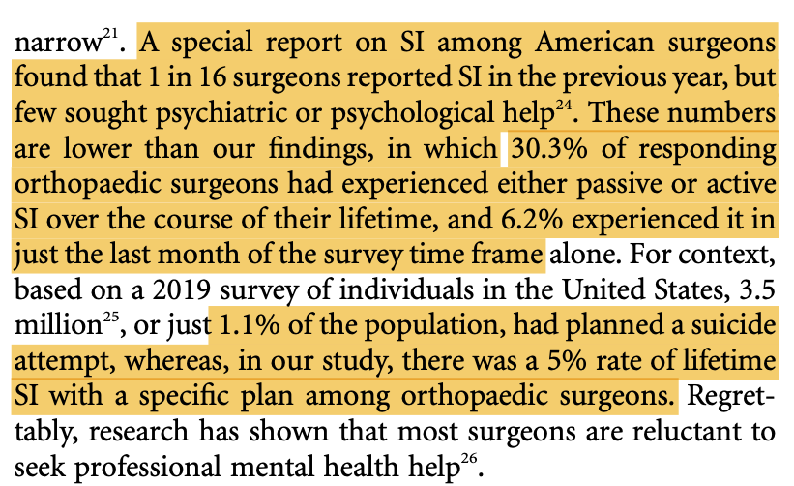
Notes:
In this paper almost a third of orthopedist had a history of suicidal thoughts, and 6% had these thoughts within the last month.

Slide 6


That’s not the only article showing increased suicidal ideation
Notes:
The problem of physician strain and suicidal feelings is not limited to surgeons, as shown in this 2022 article published in the Proceedings of the Mayo Clinic.

Slide 7
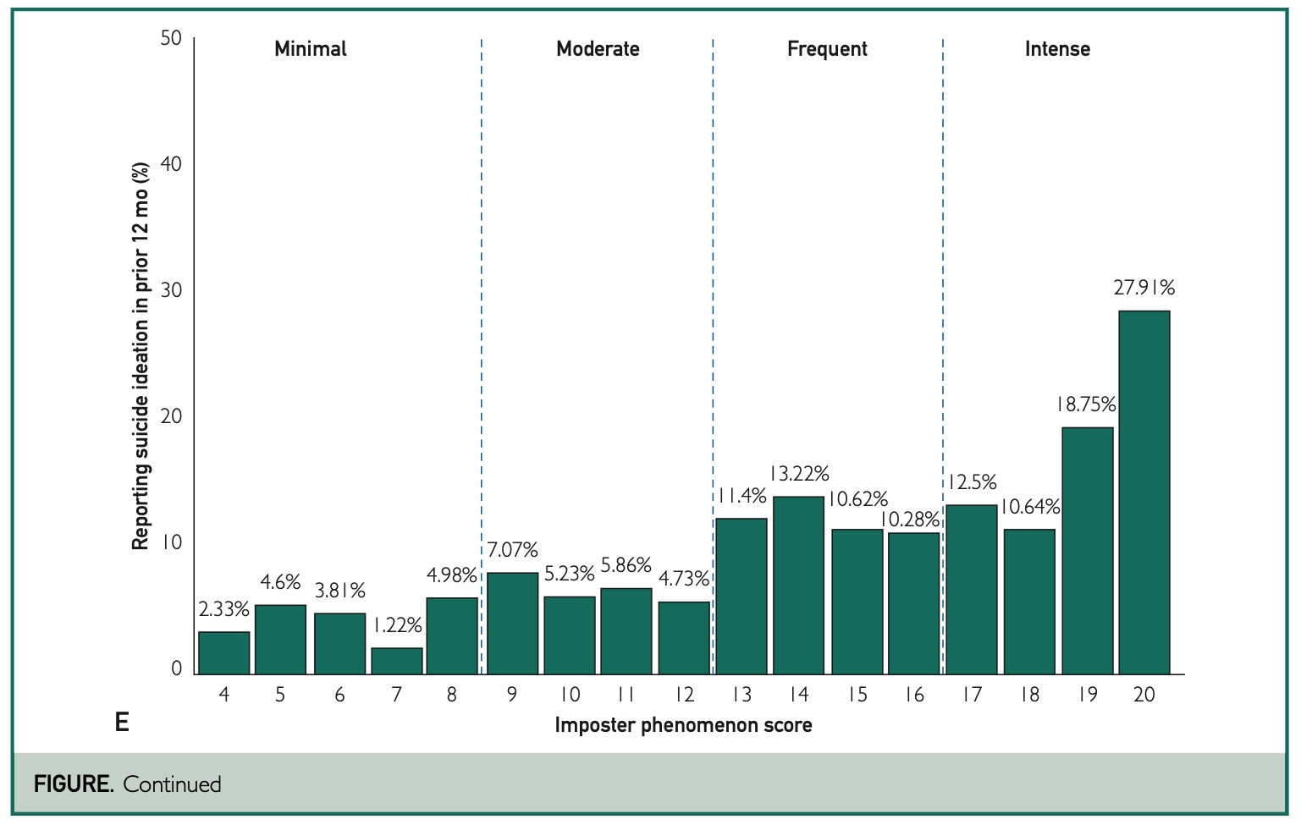
Suicidal ideation is too common among physicians
Notes:
In this study examining imposter phenomenon (where one fears they are an imposter, and may be undeserving of their accomplishments), suicidal thoughts were examined for frequency within the last year and reported in groups of people based on severity of imposter phenomenon. Overall, there was a higher correlation between the percentage of physicians with suicidal thoughts and severit of imposter phenomenon… Including, alarmingly, that in those with the worst imposter phenomenon that over a quarter reported suicidal ideation in the last year.

Slide 8



Medical students are also under pressure, and often don’t seek treatment
Notes:
The previous studies were with physicians, but this paper in was done in students. It also shows students are under pressure, and often don’t seek treatment.

Slide 9
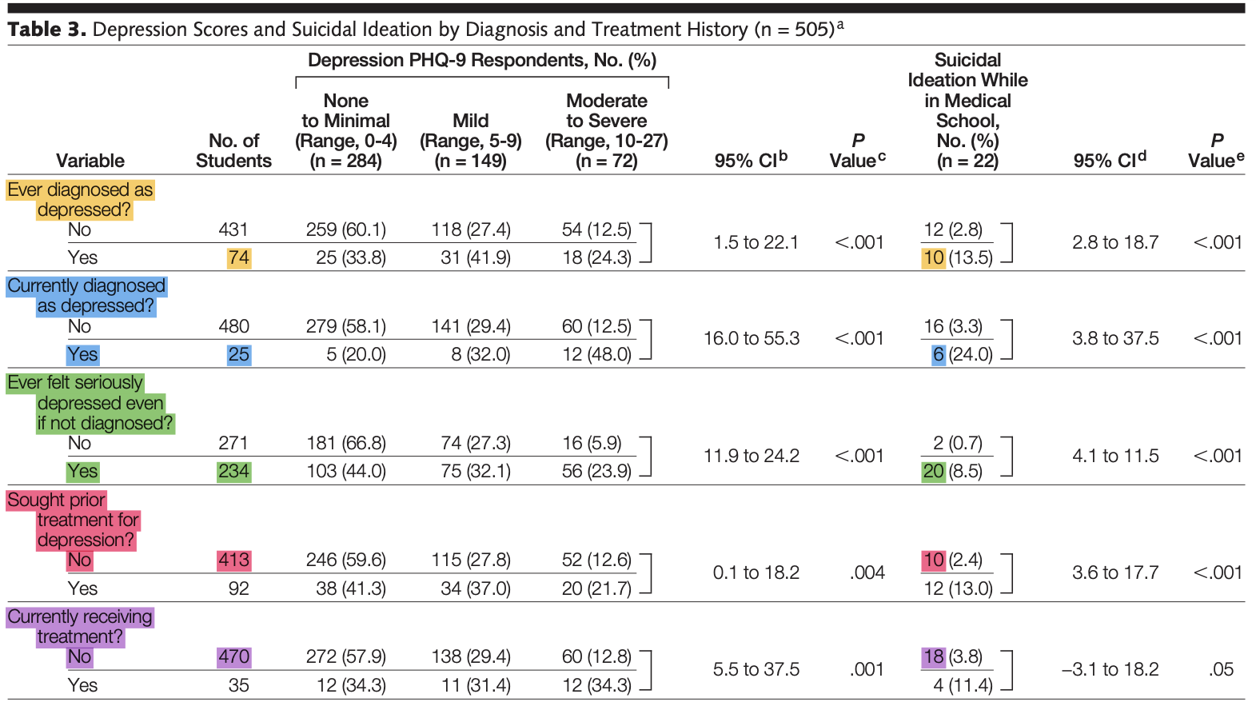
Notes:
This slide has a lot of data, and is reporting depression scores and suicidal ideation by diagnosis and treatment history. This study is from several years ago, and challenges for students have increased since then.
Specifically, in this study of over 500 medical students:
Almost half had been seriously depressed even if not diagnosed. Twenty of those had suicidal ideation while in school.
Less than a quarter had sought treatment for depression, despite 10 of those students having suicidal thoughts while in school
Less than 1 in 10 were currently receiving treatment, and of those students not getting treatment 18 had suicidal thoughts while in medical school

Slide 10

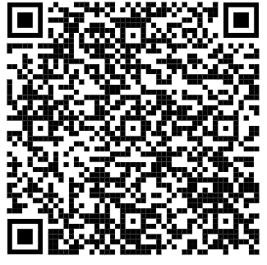
Does having a mental health diagnosis affect quality of care?
Notes:
We’ve described that suicidal thoughts are not uncommon, and neither is depression. Does having a mental health diagnosis affect quality of care? This article sought to better understand that.

Slide 11
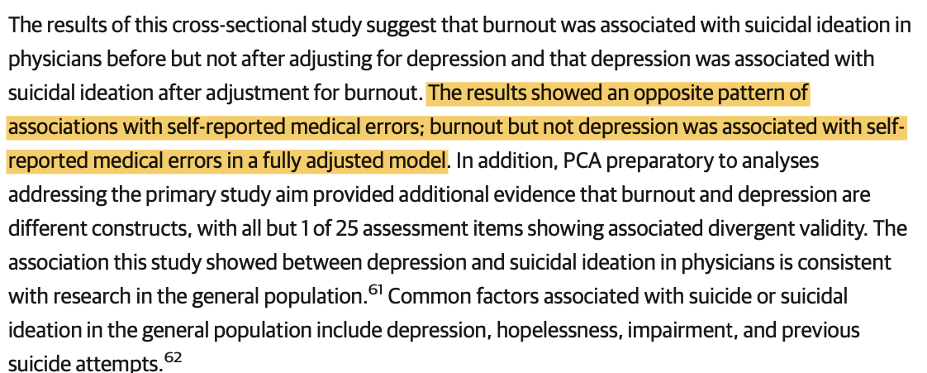
Burnout is associated with medical errors - not depression
Notes:
But in this study it was found that burnout was associated with medical errors, but depression was not. (It also found relationships between burnout and depression and suicidal ideation.)

Slide 12
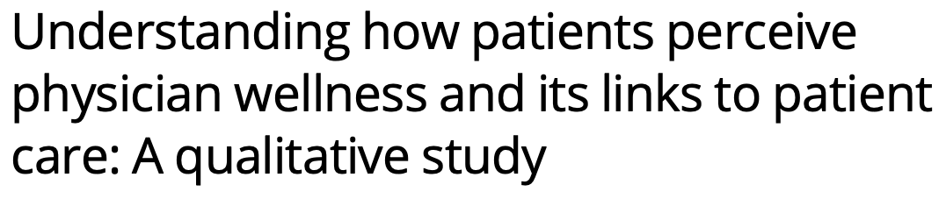

Patients care about physician wellness
Notes:
The last paper helped demonstrate that it’s important we address physician wellness for physicians, but also for patient care and quality of care. This article explored how patients feel about physician wellness.

Slide 13
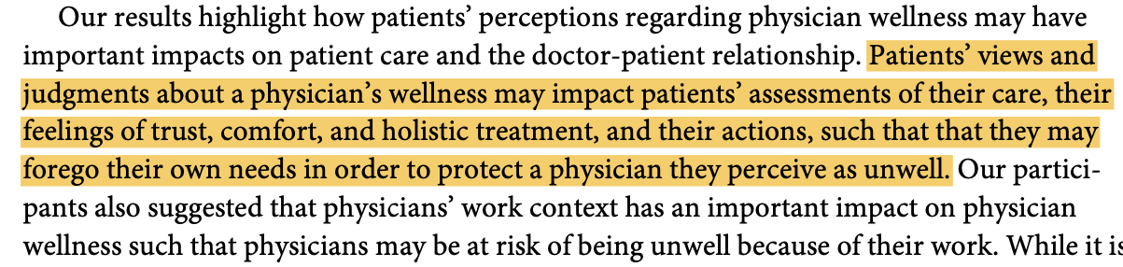
Patients’ beliefs about physician wellness affect how they feel about their care

Slide 14
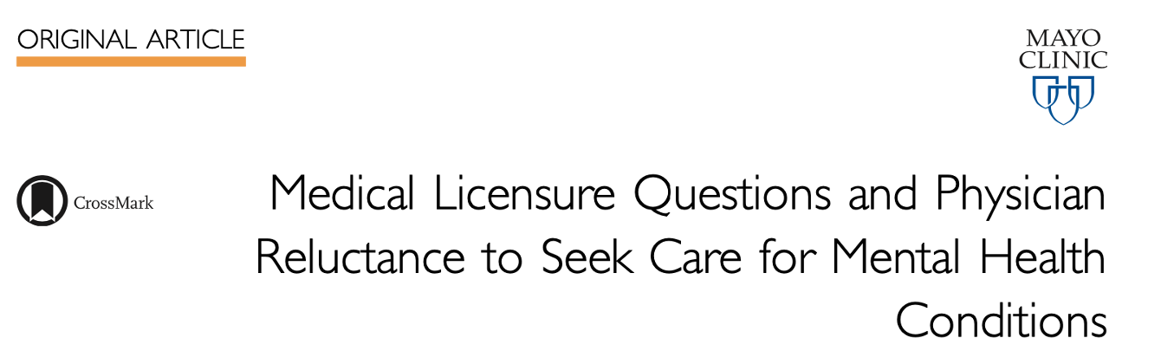

There are known barriers to physicians receiving mental health care, including fearing effects on their ability to practice
Notes:
These articles help support doing what we can to support physicians receiving mental health care.
Unfortunately, there are many known barriers to physicians receiving mental health care - including fearing effects on their ability to practice medicine. Specifically, this study examined if physicians living in states where medical license applications ask if the physician has received mental health care or has a mental health diagnosis.

Slide 15
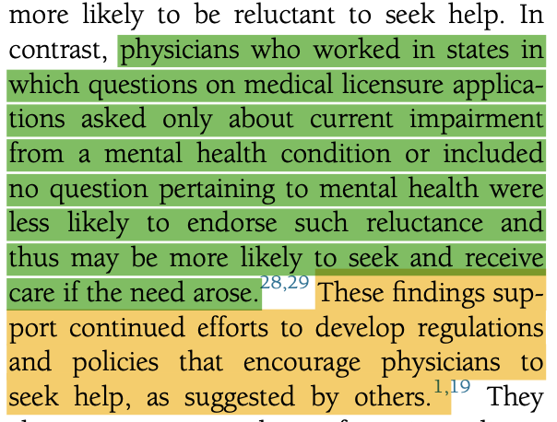
Physicians living in states that ask about mental health care on license applications are more reluctant to seek mental health care
Notes:
The study found that physicians living in states that ask about mental health care on license applications are more reluctant to seek mental health care. Specifically: ‘physicians who worked in states in which questions on medical licensure applications asked only about current impairment from a mental health condition or included no question pertaining to mental health were less likely to endorse such reluctance and thus may be more likely to seek and receive care if the need arose’

Slide 16
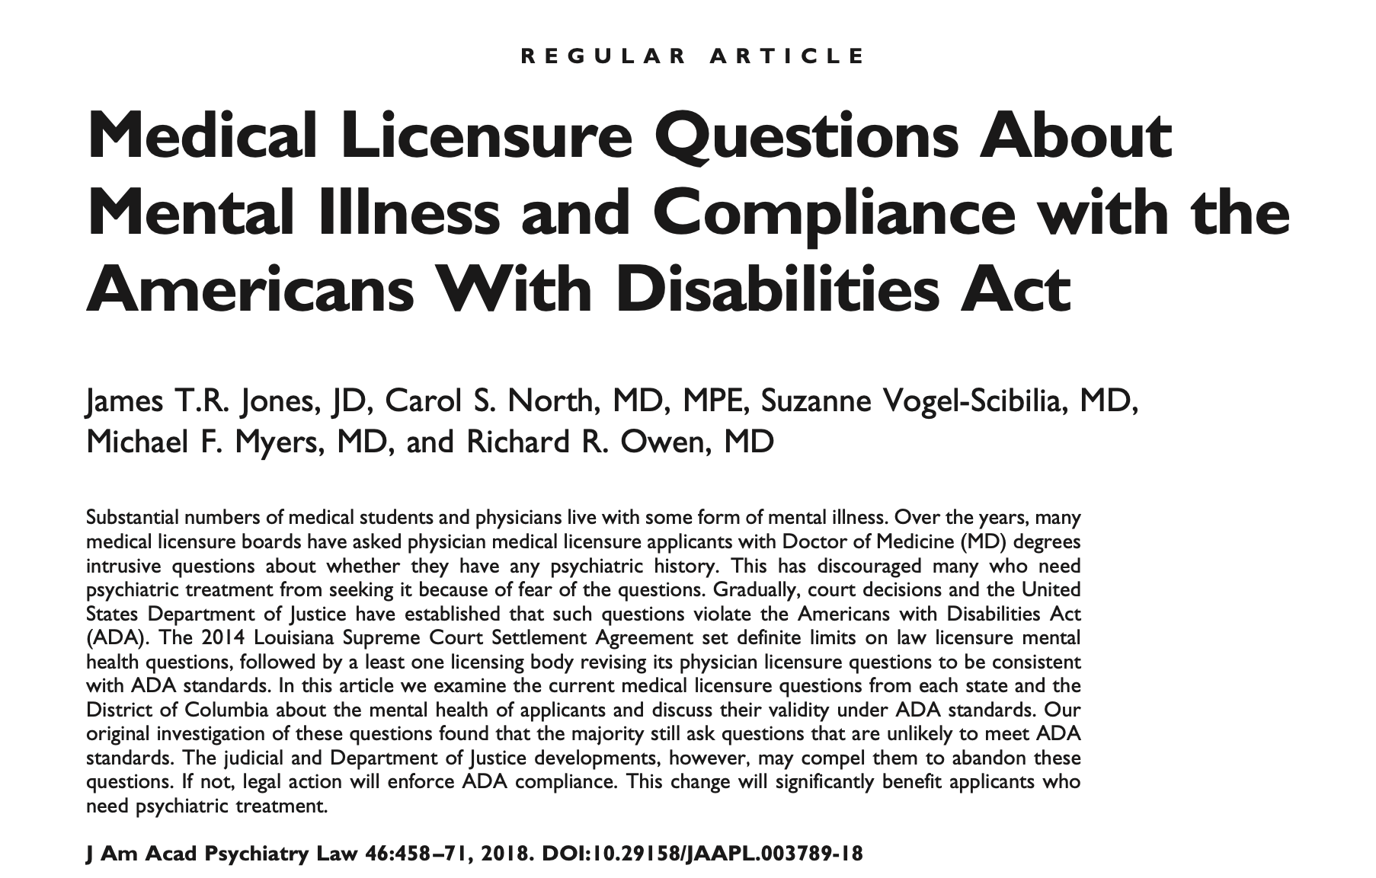
Asking questions about mental health may run afoul of the Americans with Disabilities Act
Notes:
When states or organizations ask about mental illness, they may not be in compliance with the Americans with Disabilities Act - which poses a liability.

Slide 17


Notes:
Credentialing applications often also ask questions about physician mental health, and also risk running afoul of the Americans with Disabilities Act. The most recent version of the AMA’s Physician’s Guide to Medical Staff Organization Bylaws give us guidance for another way.

Slide 18
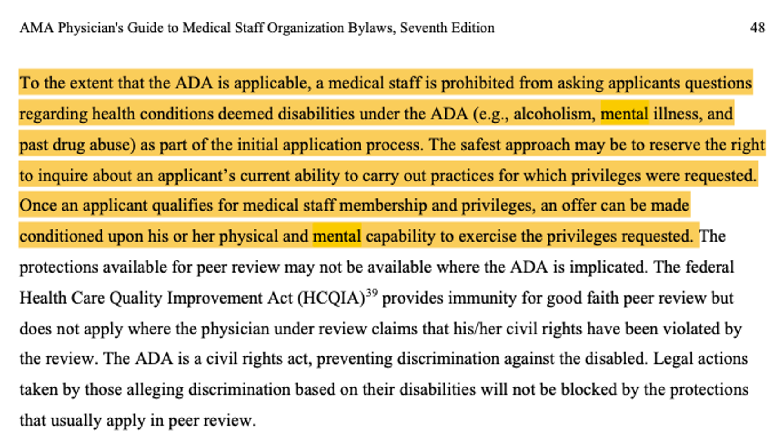
Notes:
The draft guidelines acknowledge that asking such questions may violate the Americans with Disabilities Act, and specifically reads: “
To the extent that the ADA is applicable, a medical staff is prohibited from asking applicants questions regarding health conditions deemed disabilities under the ADA (e.g., alcoholism, mental illness, and past drug abuse) as part of the initial application process. The safest approach may be to reserve the right to inquire about an applicant’s current ability to carry out practices for which privileges were requested.”

Slide 19
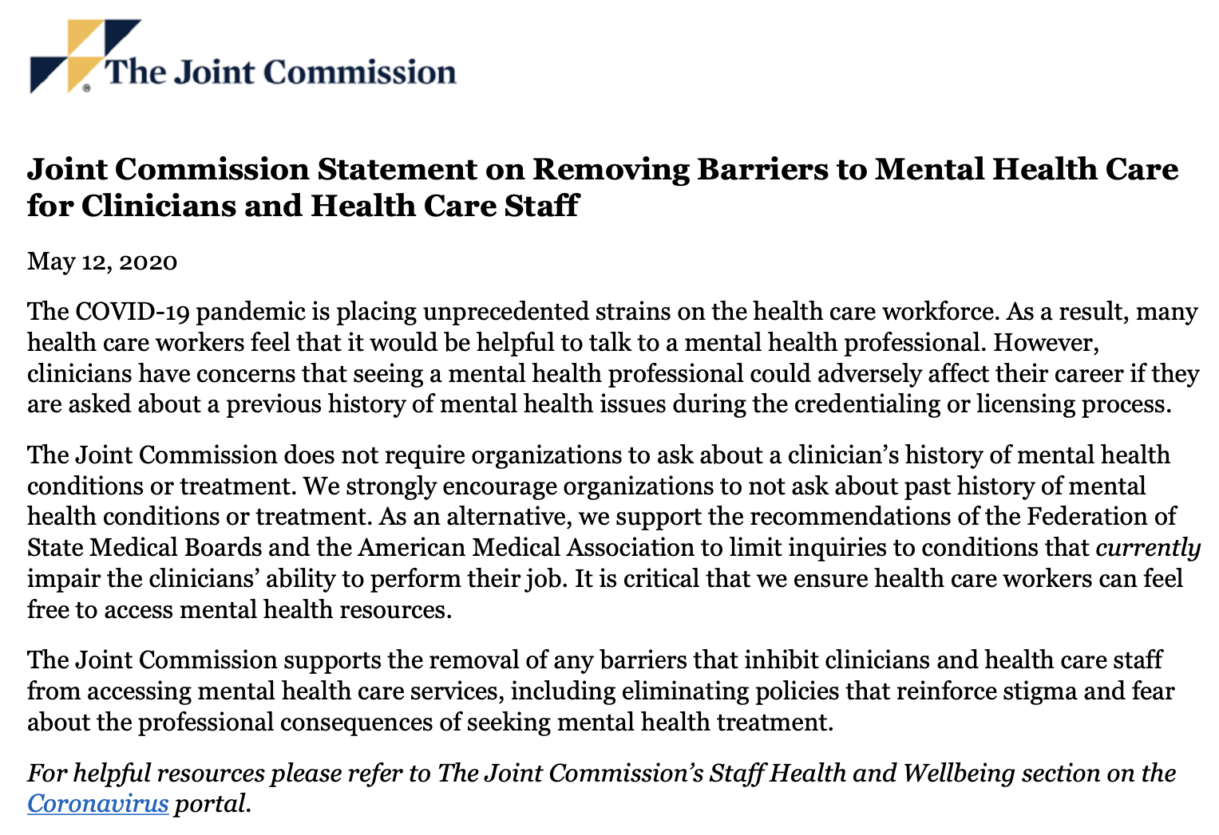
Organizations are not required to ask about mental health
Notes:
Our organizations are not required to ask about applicants mental health, and the Joint Commission issued this statement in 2020.

Slide 20
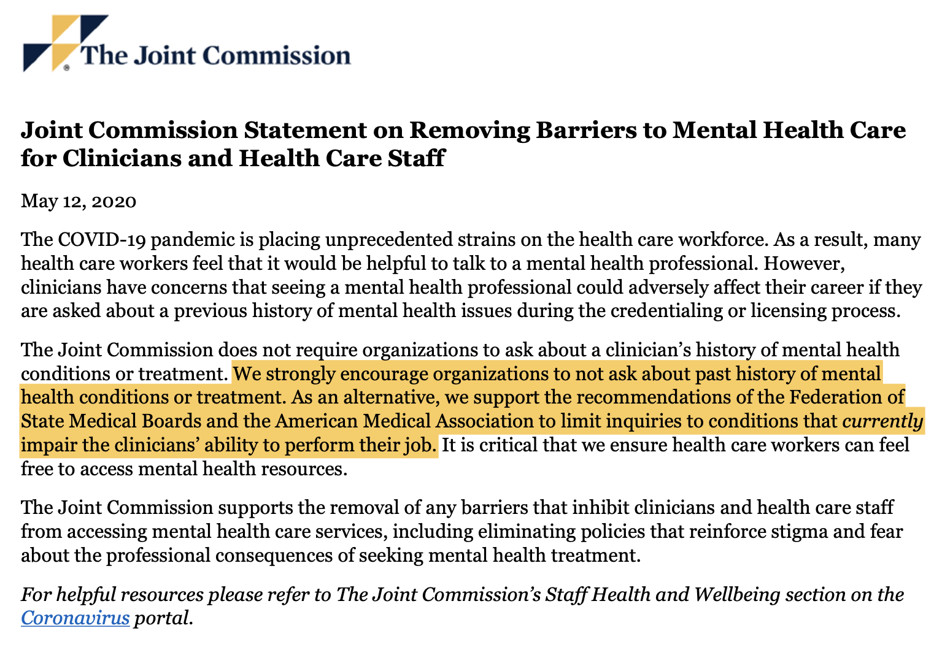
Organizations are recommended not to ask about mental health
Notes:
In fact, the Joint Commission “strongly encourages organizations to not ask about a past history of mental health conditions or treatment.” They support recommendations from others to limit inquiries to conditions that currently impair the clinician - not the presence of the diagnosis, in and of itself.

Slide 21
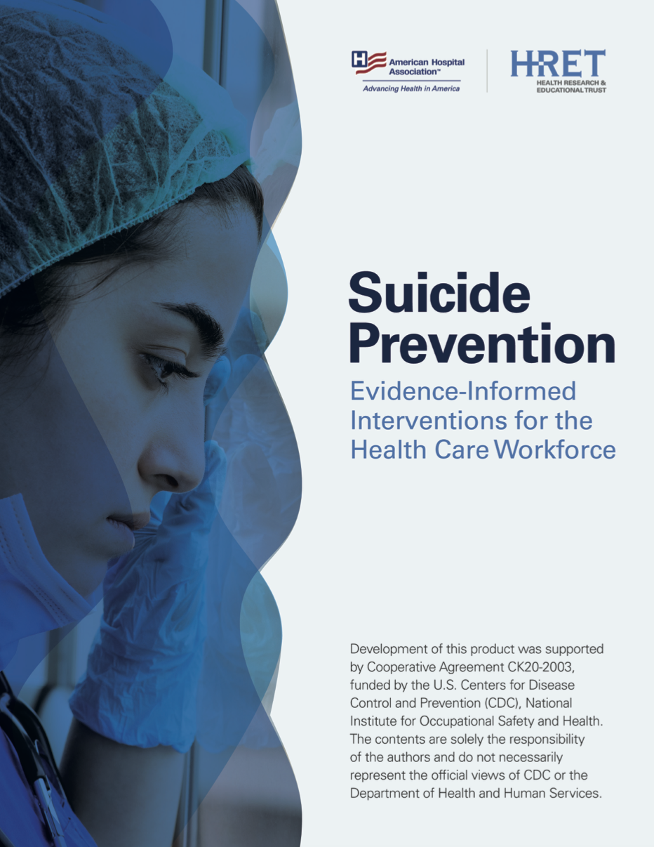
Organizations are recommended to adopt suicide prevention steps
Notes:
Not asking these questions about mental health is also consistent with recommendations to adopt suicide prevention steps, such as those recommended by the American Hospital Association

Slide 22
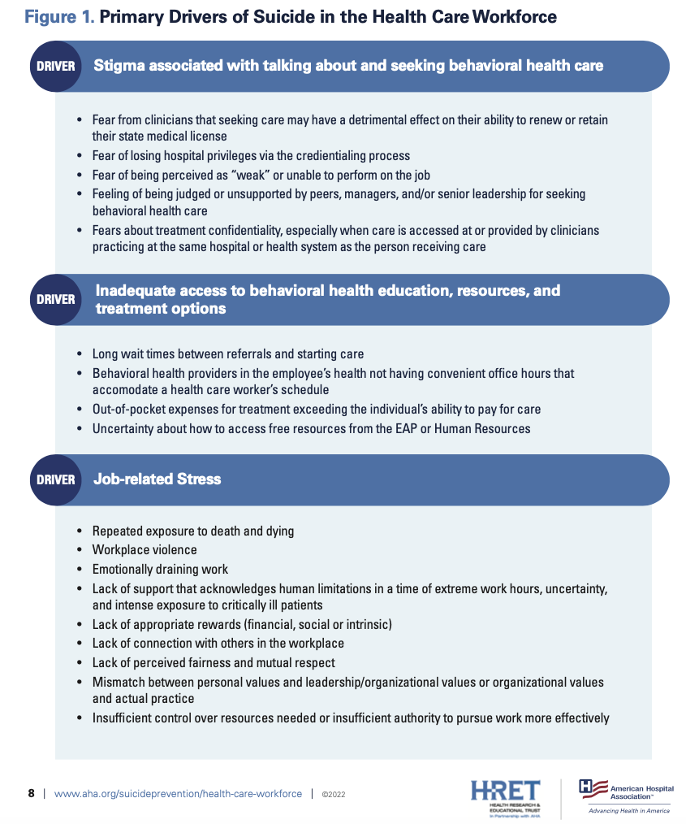
Stigma around mental health is a driver of suicide risk
Notes:
In this guide, the American Hospital Association notes that stigma around mental health is a driver of suicide risk.

Slide 23
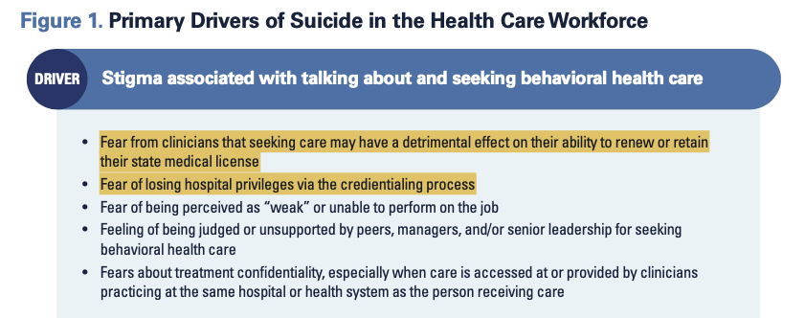
Stigma around mental health is a driver of suicide risk

Slide 24
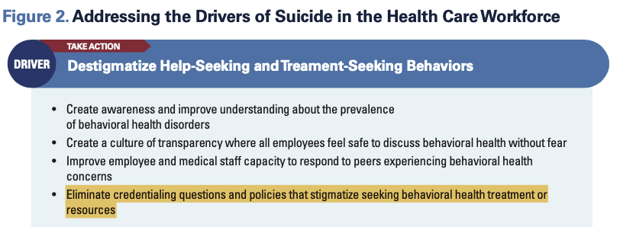
Organizations are recommended not to ask about mental health on credentialing applications to reduce suicide risk
Notes:
When listing steps to address the drivers of suicide in the health care workforce, they specifically recommend organizations “eliminate credentialing questions and policies that stigmatize seeking behavioral treatment or resources”

Slide 25
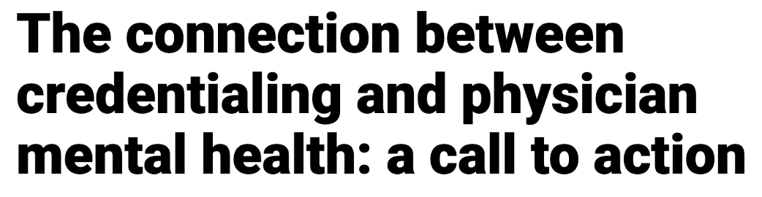

There are other ways to ask about conditions that affect patients while still reducing stigma and offering support
Notes:
If you’re wondering what to do to reduce stigma and reduce barriers to physicians seeking mental health care, there is guidance. You can ask different questions, and lend support, as is recommended in this article from Modern Healthcare

Slide 26
Ask instead:
“Do you currently have any condition that adversely affects your ability to practice medicine in a safe, competent, ethical and professional manner?"
Notes:
You can change the questions on your application to no longer ask about receiving mental health care or having a diagnosis, and instead ask this: “Do you currently have any condition that adversely affects your ability to practice medicine in a safe, competent, ethical and professional manner?"

Slide 27
And offer support:
"It is common for clinicians to feel overwhelmed from time to time and to seek help when appropriate. We emphasize the importance of wellbeing and appropriate treatment and support for all health conditions."
Notes:
It is also good to offer a supportive statement, such as this one: “"It is common for clinicians to feel overwhelmed from time to time and to seek help when appropriate. We emphasize the importance of wellbeing and appropriate treatment and support for all health conditions."

Slide 28
Conclusions and Next Steps
Physicians have threats to their mental health
Physicians have barriers to receiving mental health care
Questions about mental health are common on licensing and credentialing applications, and deter physicians from getting mental health care
Credentialing and licensing questions should be changed not to ask about mental health, and to support mental health care
Notes:
Now that we’ve reviewed stories and articles, barriers, and solutions, here are conclusions and next steps.

Slide 29
Conclusions and Next Steps
Physicians have threats to their mental health
Physicians have barriers to receiving mental health care
Questions about mental health are common on licensing and credentialing applications, and deter physicians from getting mental health care
Credentialing and licensing questions should be changed not to ask about mental health, and to support mental health care
Can we change our own application?

