Slide 1
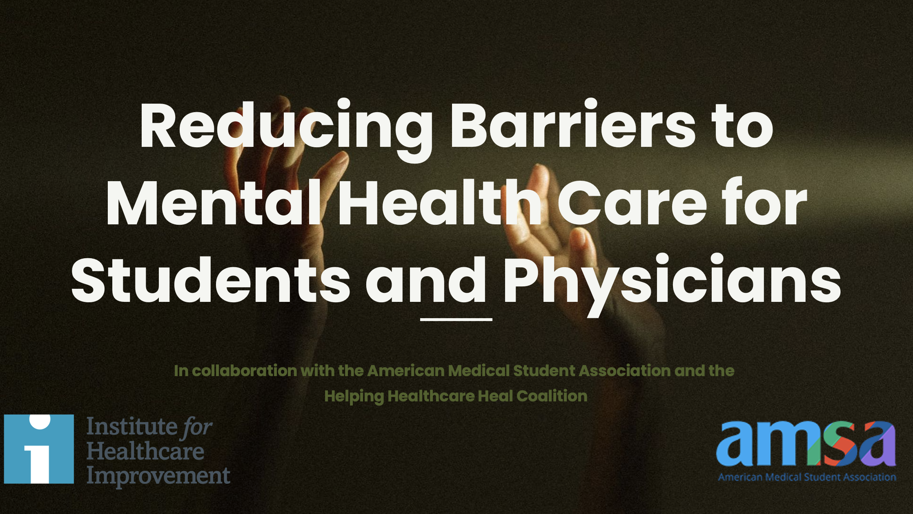
[Your name]
Notes:
Hello, and I am so happy to speak with you today about an important issue facing medical students and physicians, which is around barriers to them seeking and receiving mental health care, and what we can do to reduce those barriers.
I will be presenting from materials developed through a collaboration of the American Medical Student Association and the Institute for Healthcare Improvement.
Throughout this presentation you will see QR codes and I encourage you to use your smartphone’s camera to access those journal articles and resources.

Slide 2
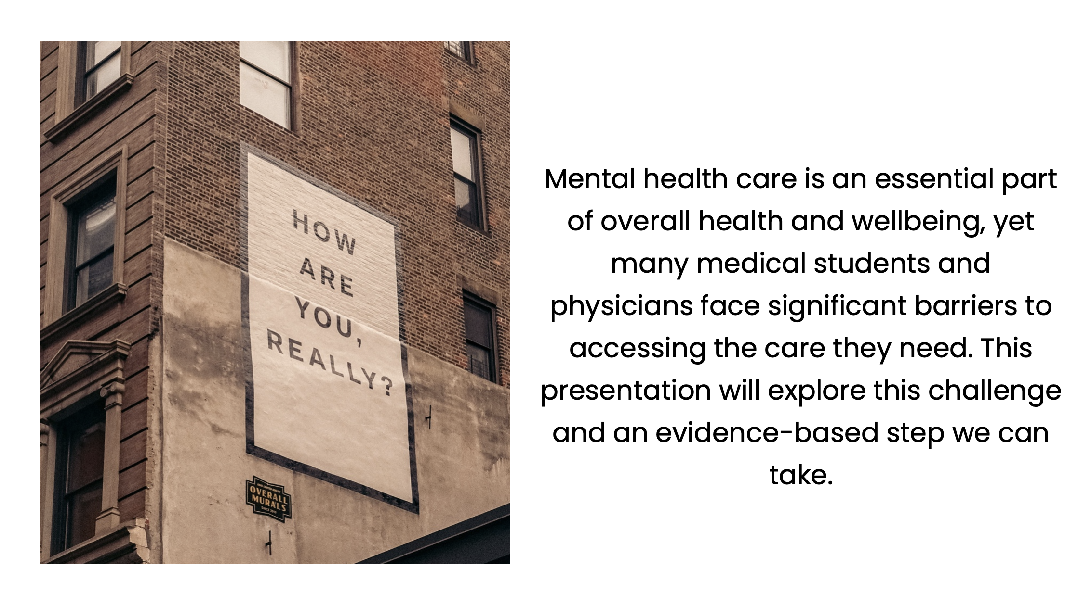
Notes:
Mental health care is an essential part of overall wellbeing, yet many physicians and medical students face barriers to accessing mental health care. This talk will outline the challenges and an evidence-based step I believe that our medical school can take to reduce barriers.

Slide 3
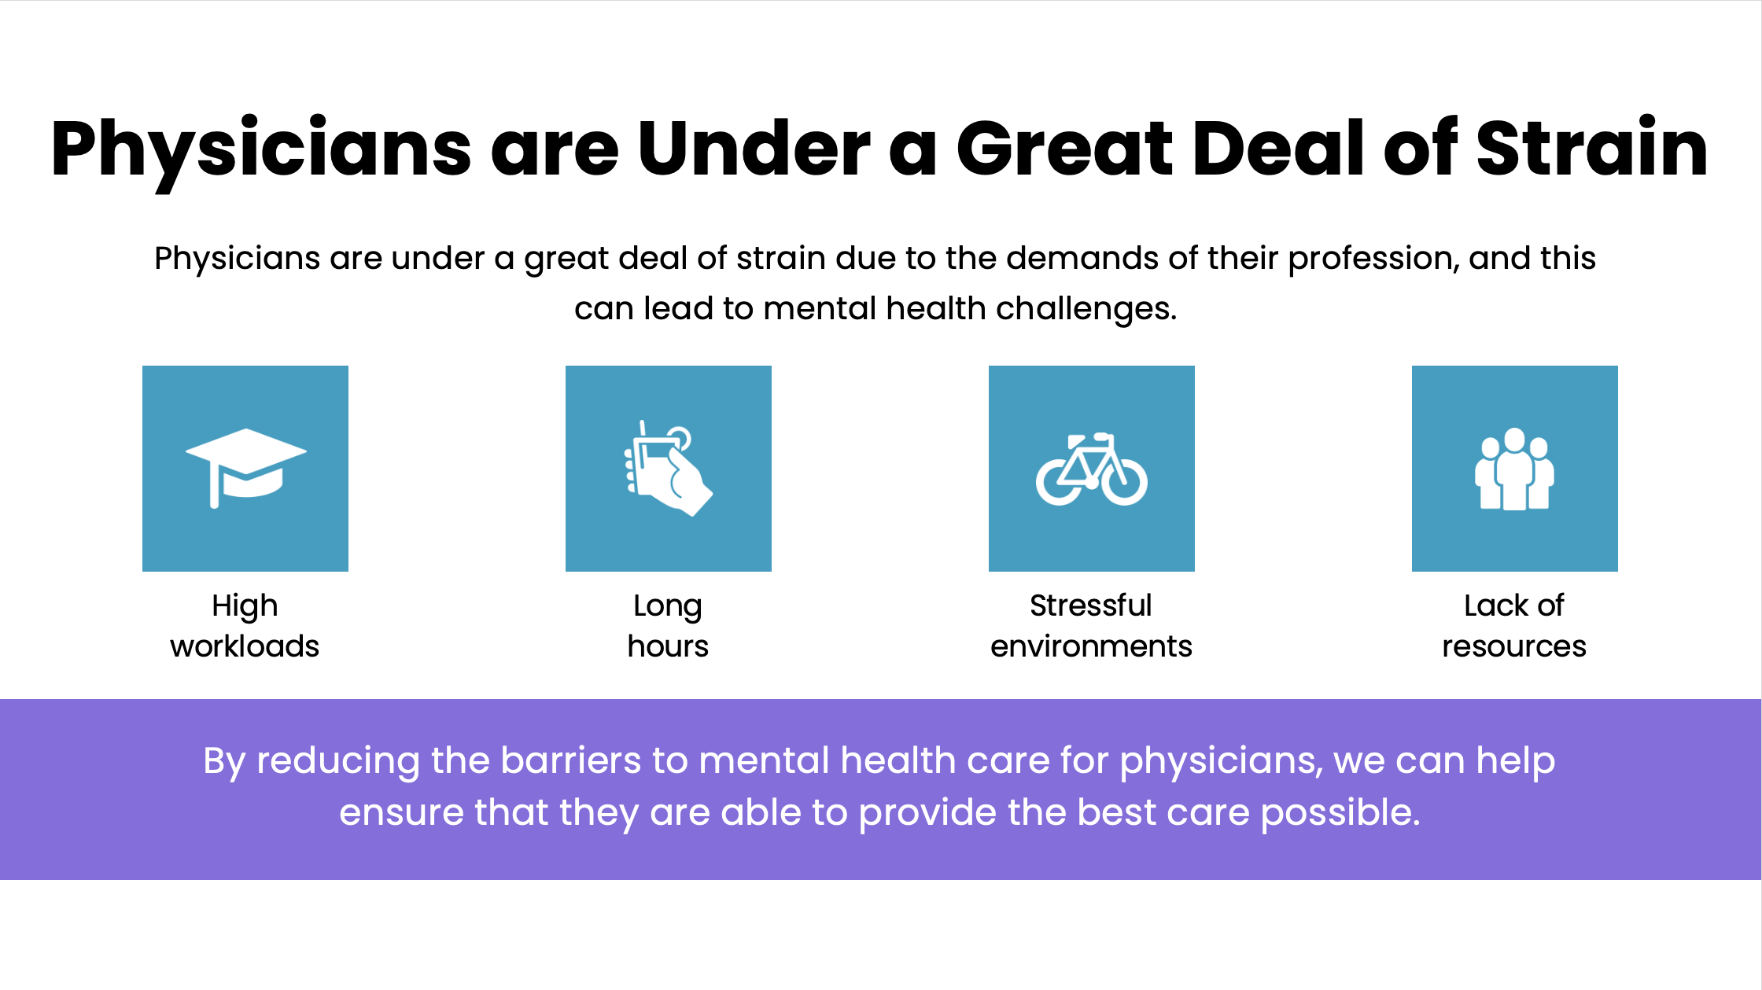




By reducing the barriers to mental health care for physicians, we can help ensure that they are able to provide the best care possible.
Notes:
Physicians are experiencing many stressors due to the demands of their work, and this can result in mental health challenges. Some of the challenges they are facing icnludign high workloads, long hours, stressful environments, and a lack of resources.
Reducing barriers to them being able to receive mental health care is important and can help them provide the best care to patients.

Slide 4
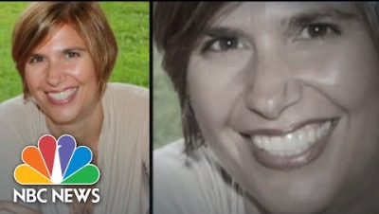
Notes:
Many of you have heard of Dr Lorna Breen, an emergency physician whose mental health deteriorated as a result of her pandemic work, and who died from suicide. Her family reported she was fearful of receiving mental health care because of fears doing so would affect her ability to keep her medical license. After her death, her family founded the Lorna Breen Foundation to reduce health care worker burnout and safeguard their well-being and job satisfaction.

Slide 5
Suicidal Ideation in Physicians
Notes:
Suicidal ideation is a serious issue that can have devastating consequences if not addressed.
It is also NOT uncommon.

Slide 6
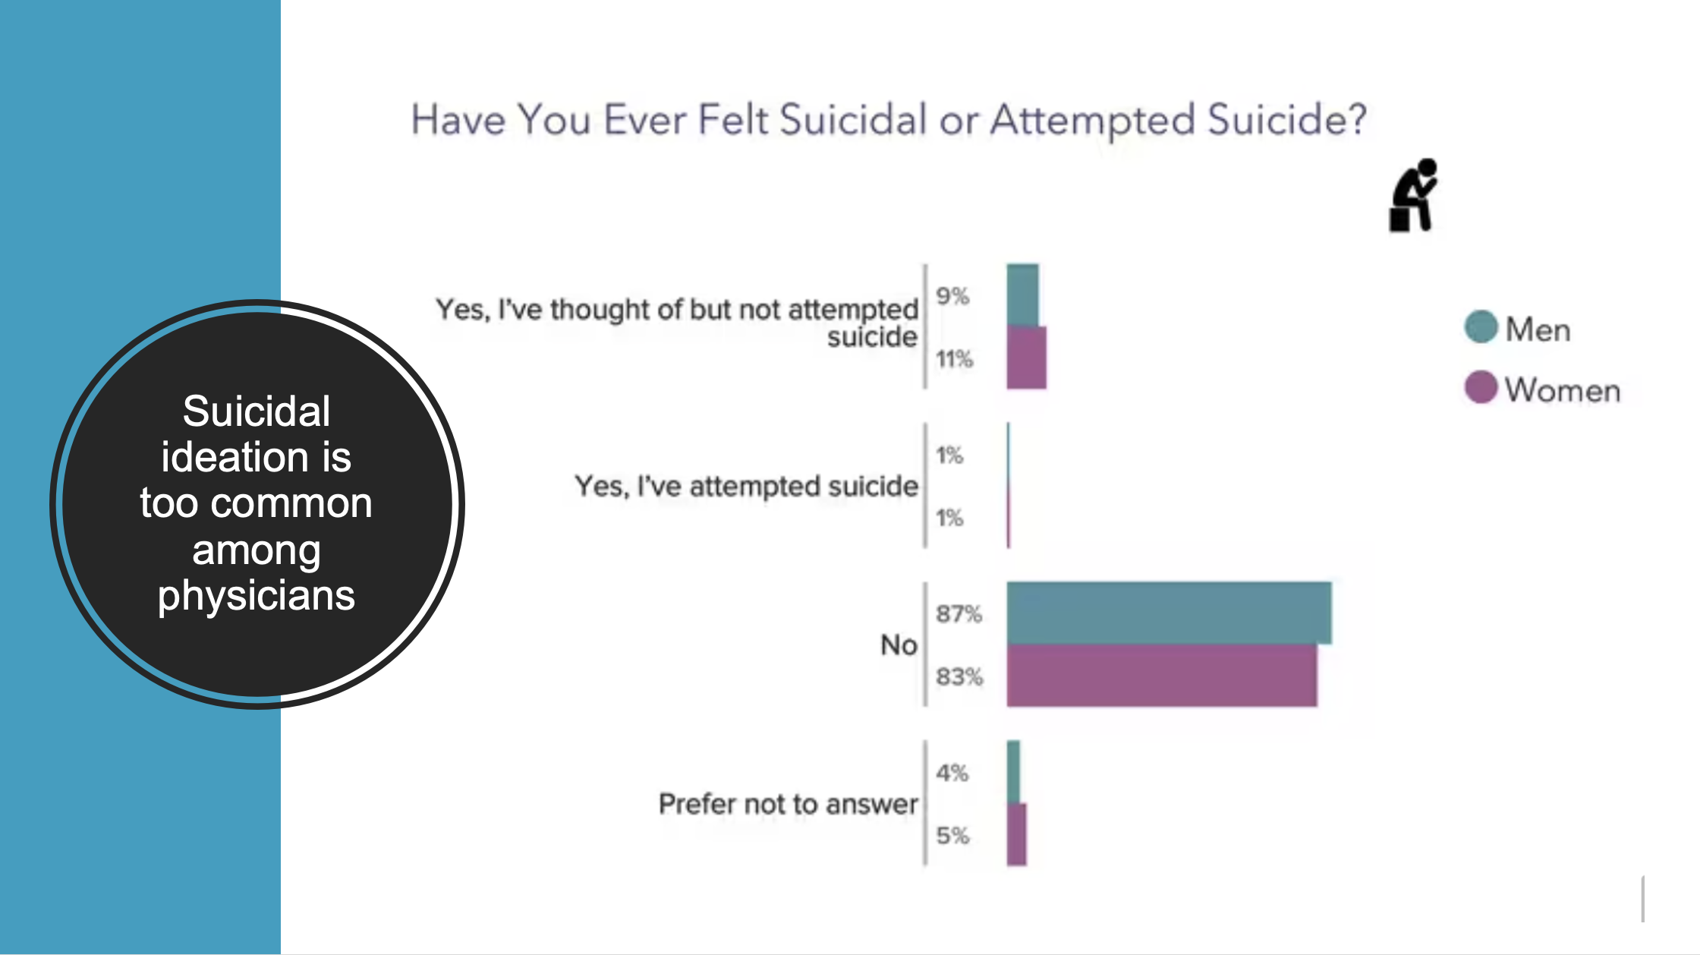
Notes:
This Medscape study surveyed practicing physicians in 2023. It found that 11% of female physicians and 9% of male physicians have thought of but not attempted sucide.
Source: https://www.medscape.com/slideshow/2023-physician-suicide-report-6016243#5

Slide 7
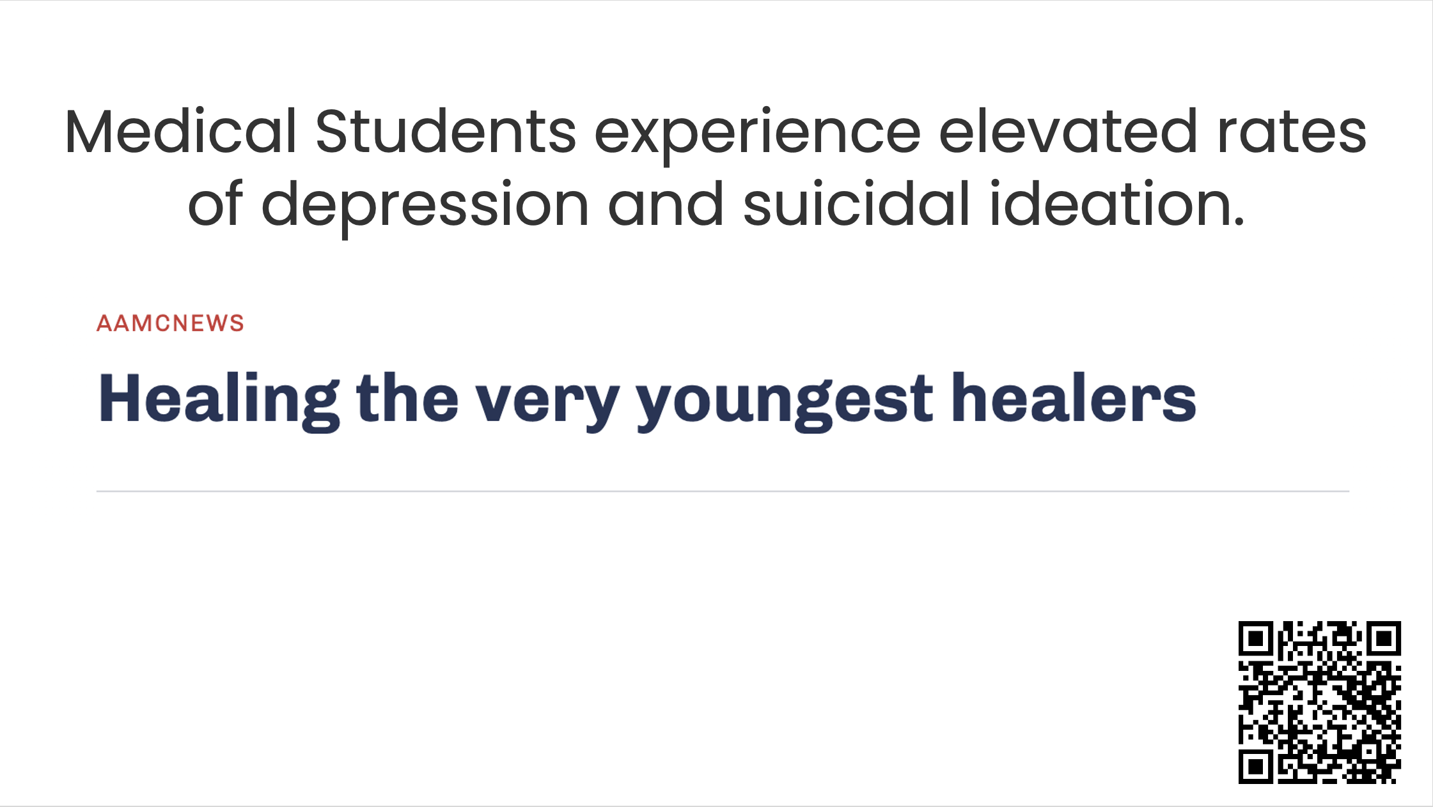
Notes:
Medical students experience elevated rates of depression and suicidal thoughts, or ideation. This is an article from the Association of American Medical Colleges (AAMC). As you may know, all accredited MD-granting medical schools in the United States and Canada are members of the AAMC.

Slide 8
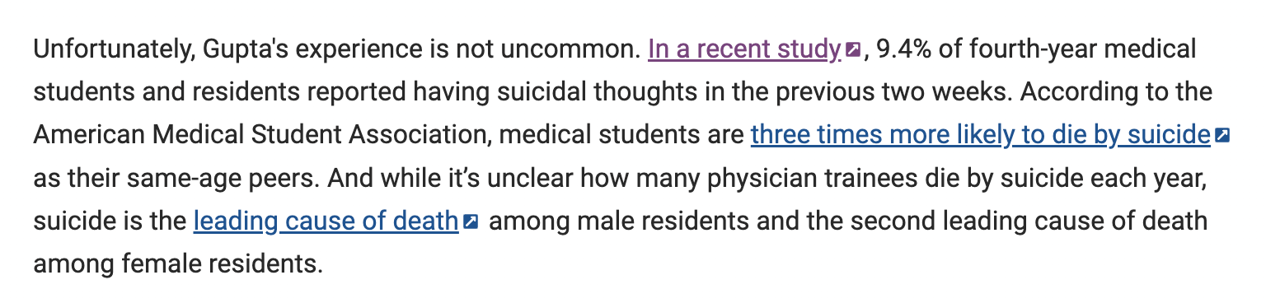
Notes:
This article states that almost 10% of medical students and residents reported having suicidal thoughts in the previous 2 weeks, and that medical students are 3x more likely to die by suicide than their peers. Also, suicide is the leading cause of death among male residents and the 2nd leading cause of death among female residents.

Slide 9
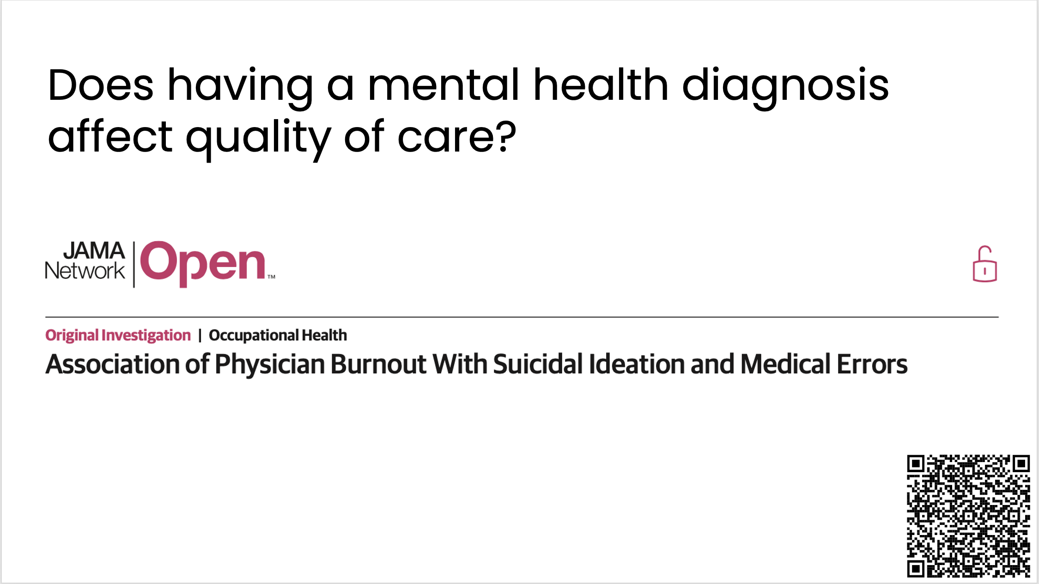
Notes:
We’ve described that suicidal thoughts are not uncommon, and neither is depression.
Sometimes people next ask does having a mental health diagnosis affect quality of care? This article sought to better understand that.

Slide 10
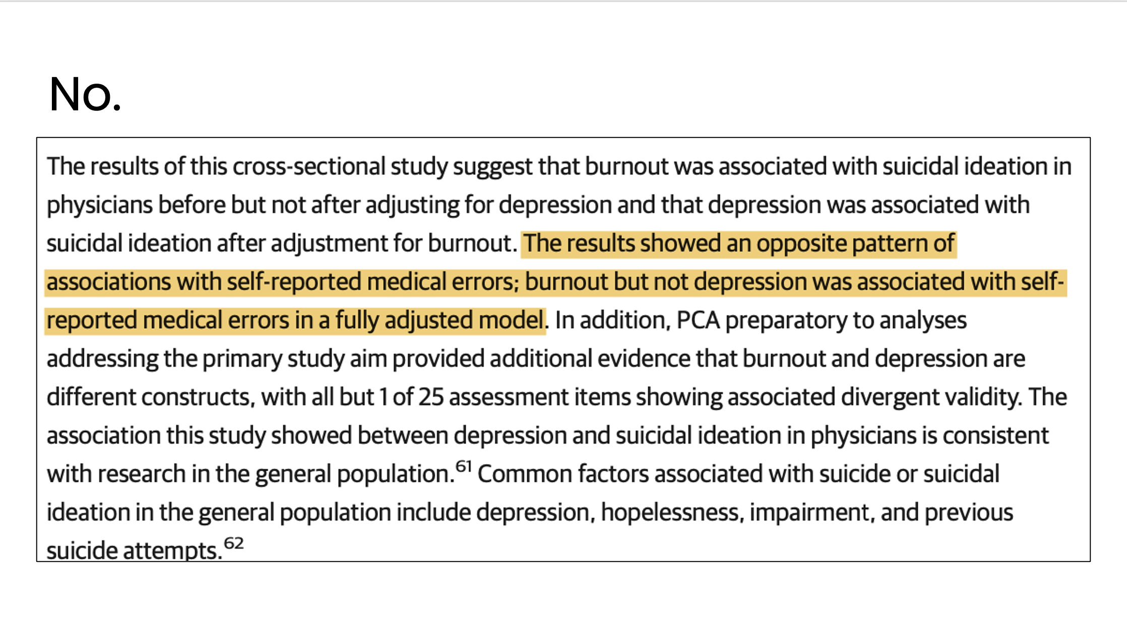
Notes:
But in this study published in JAMA Network Open, it was found that burnout was associated with medical errors, but depression was not.
(Burnout and depression are two different things, although can have a relationship)

Slide 11
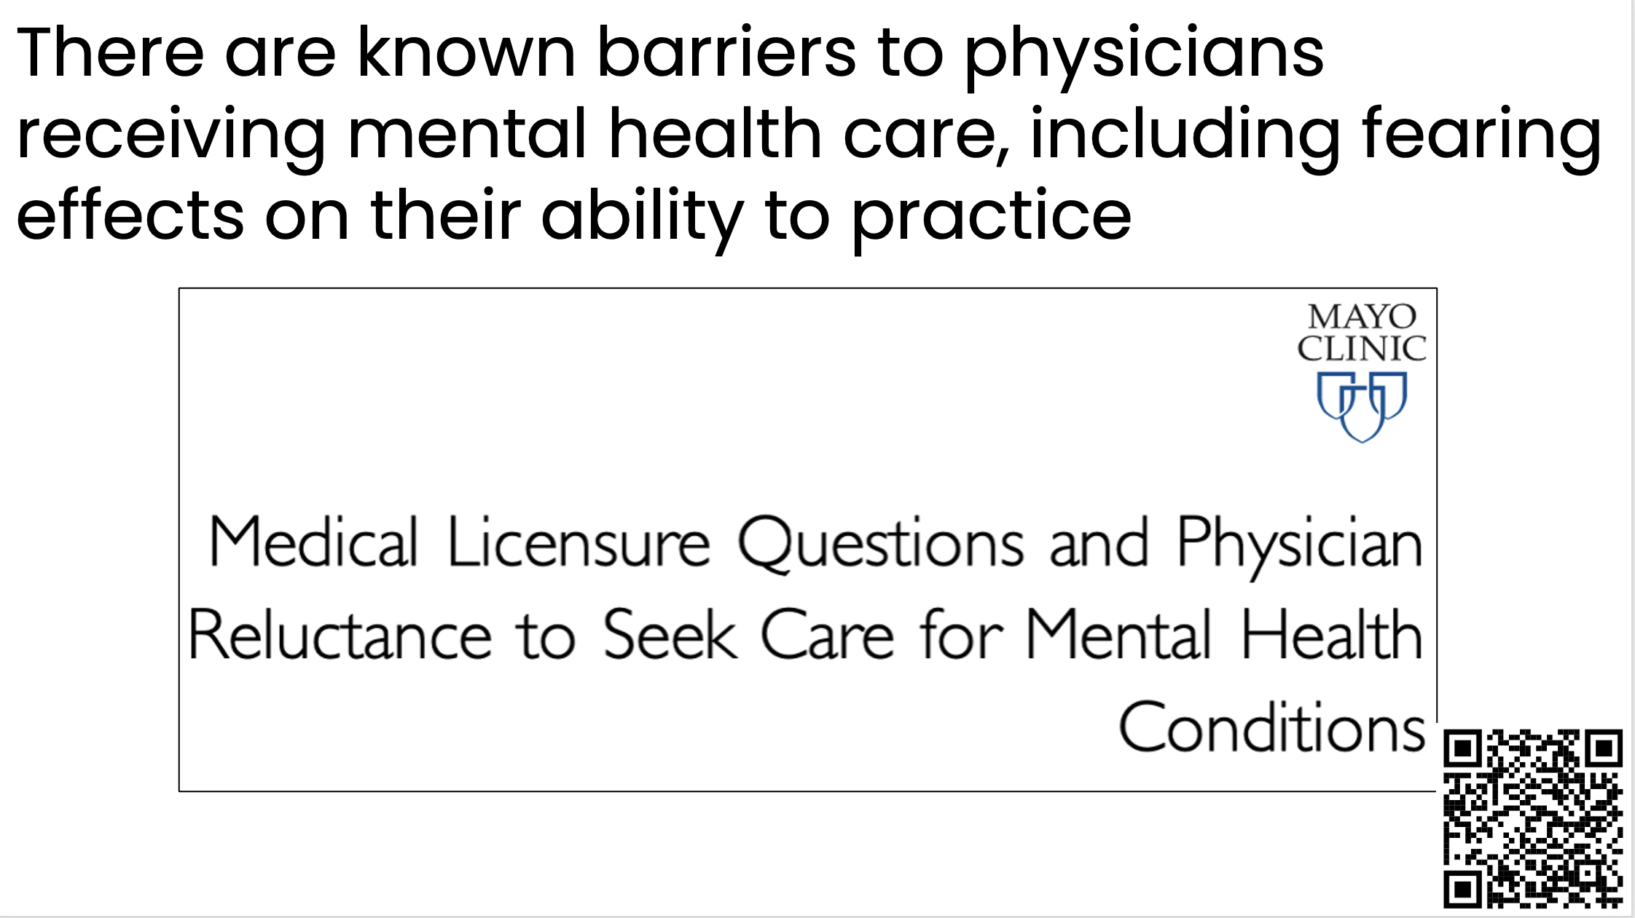
Notes:
These articles help support doing what we can to remove barriers to physicians receiving mental health care. One meaningful step we can take is to reduce fear that getting mental health care will affect your ability to practice.
Specifically, this study in the Mayo Clinic Proceedings examined if physicians living in states where medical license applications ask if the physician has received mental health care or has a mental health diagnosis is related to reluctance to seek mental health care.

Slide 12
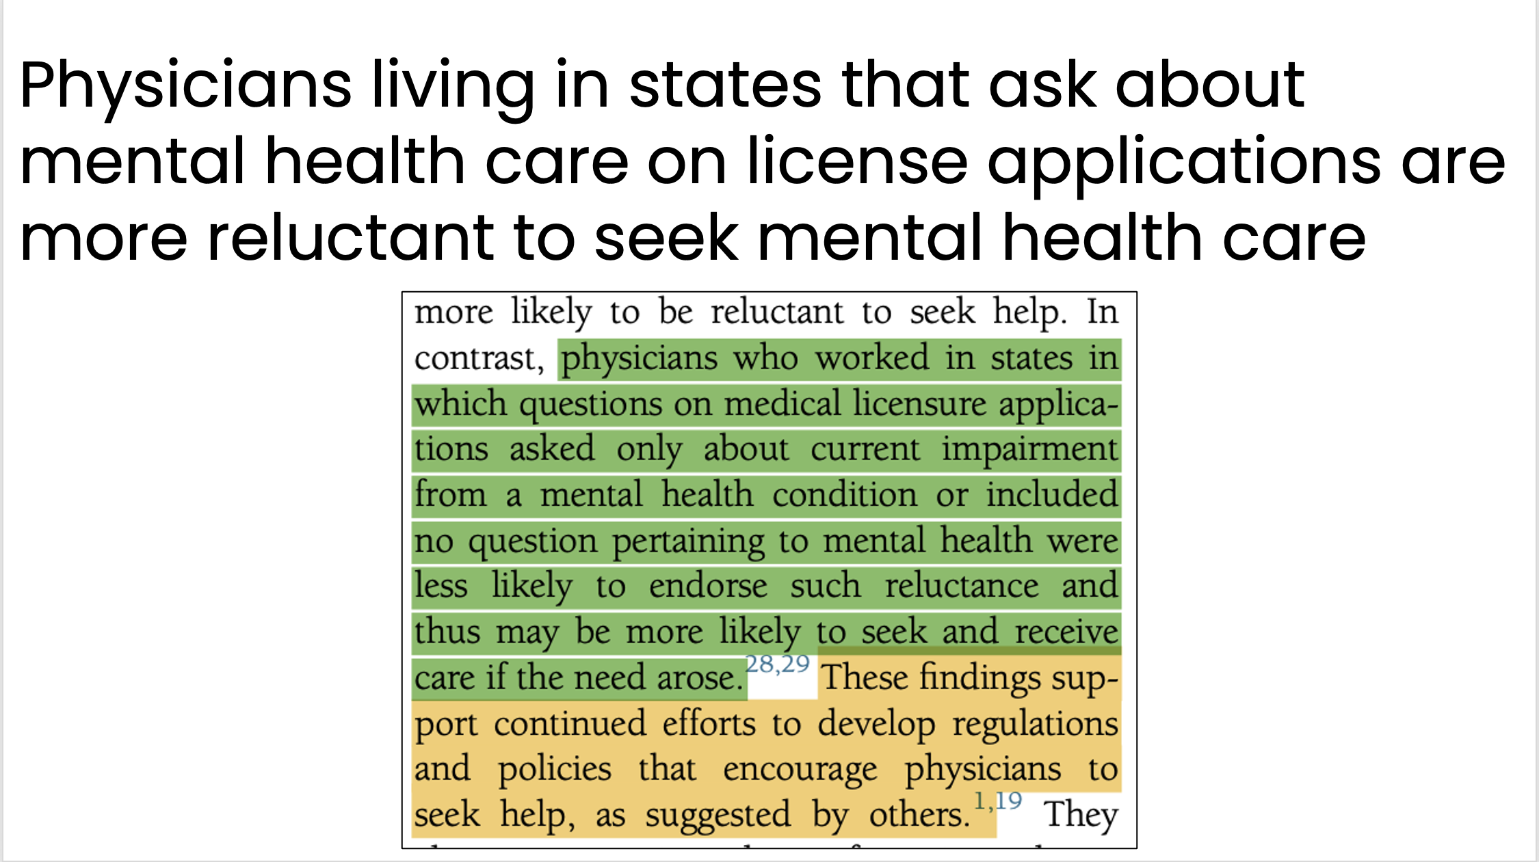
Notes:
The study found that physicians living in states that ask about mental health care on license applications are more reluctant to seek mental health care. Specifically: ‘physicians who worked in states in which questions on medical licensure applications asked only about current impairment from a mental health condition or included no question pertaining to mental health were less likely to endorse such reluctance and thus may be more likely to seek and receive care if the need arose’
Also, ‘These findings support continued efforts to develop regulations and policies that encourage physicians to seek help…’

Slide 13
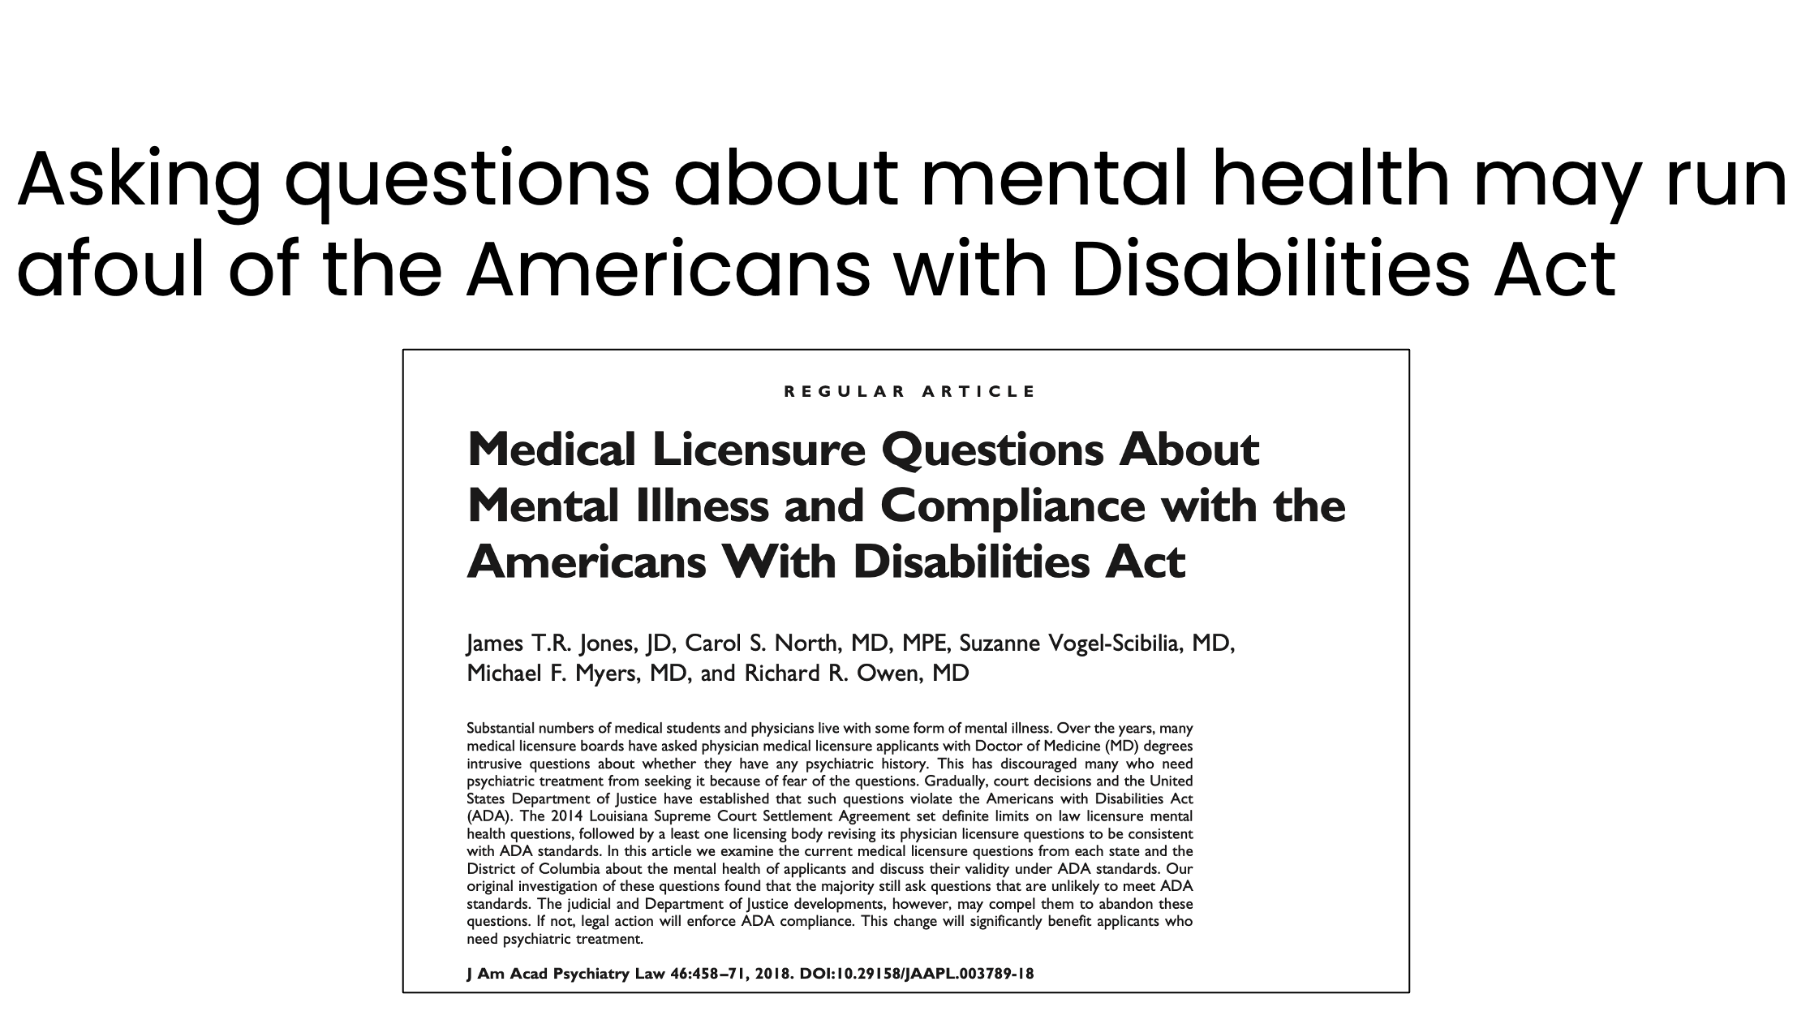
Notes:
There are other good reasons not to ask about mental health on medical applications. This paper in the Journal of the American Academy of Psychiatry and the Law describes how when states or organizations ask about mental illness, they may not be in compliance with the Americans with Disabilities Act - which poses a liability.

Slide 14
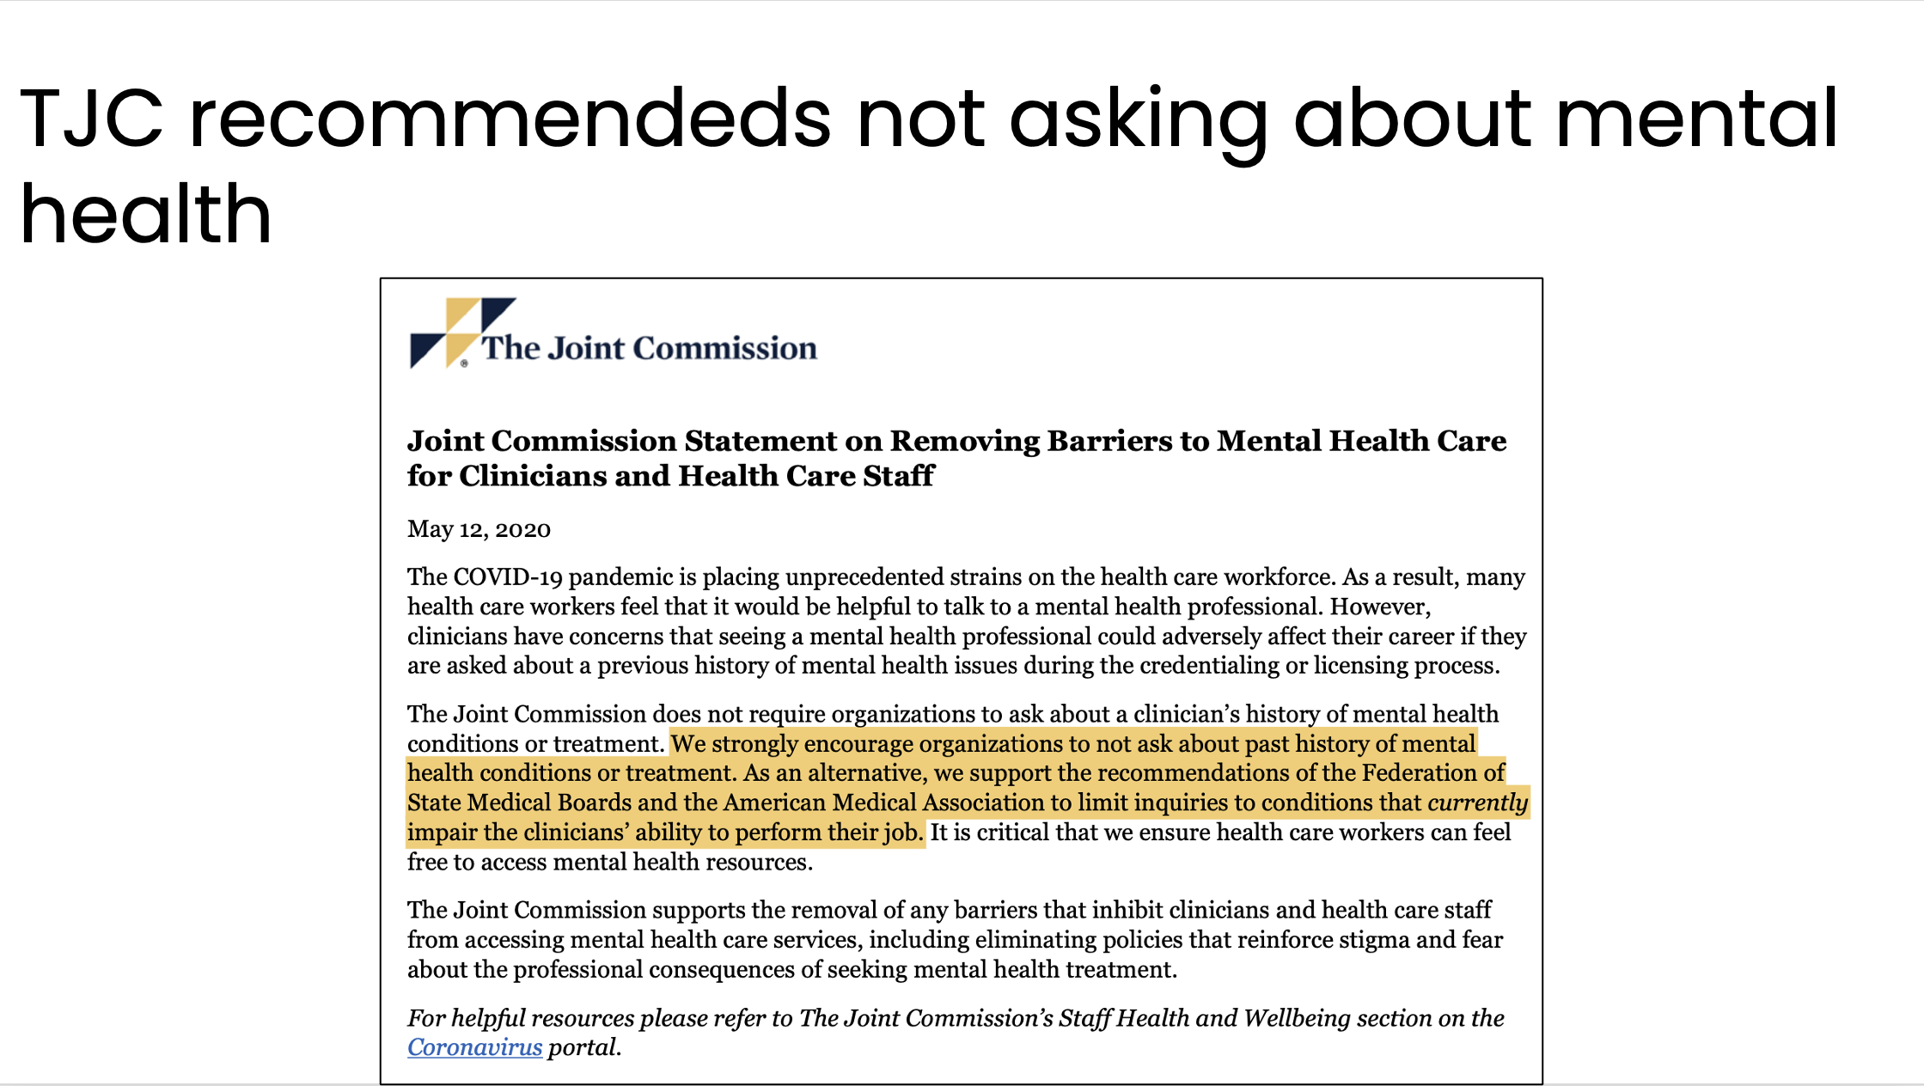
Notes:
In fact, the Joint Commission “strongly encourages organizations to not ask about a past history of mental health conditions or treatment.” They support recommendations from others to limit inquiries to conditions that currently impair the clinician - not the presence of the diagnosis, in and of itself.

Slide 15
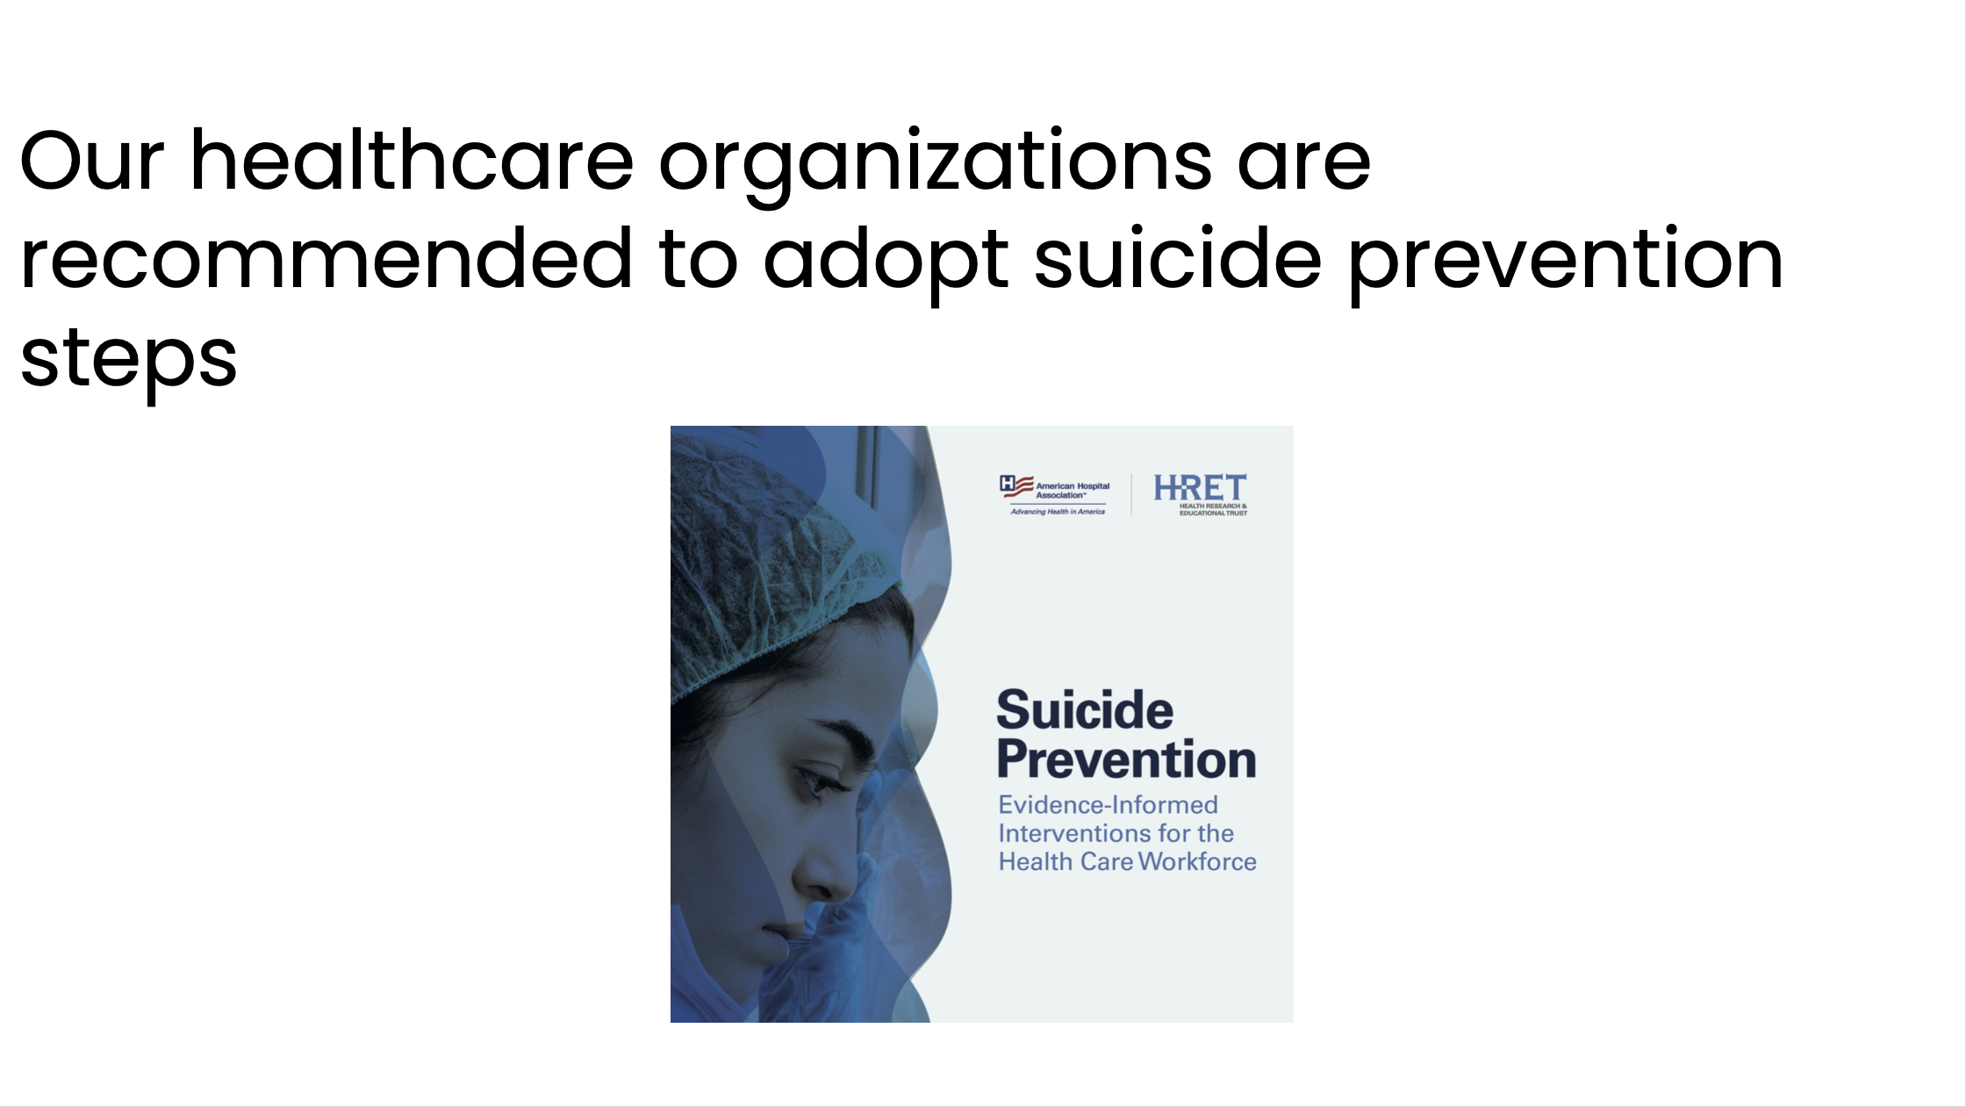
Notes:
Not asking these questions about mental health is also consistent with recommendations to adopt suicide prevention steps, such as those recommended by the American Hospital Association

Slide 16
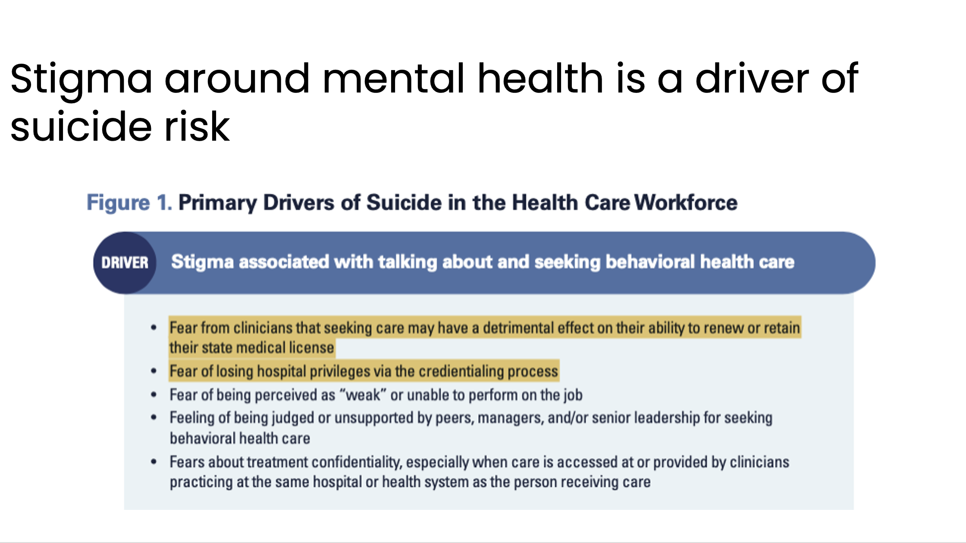
Notes:
This report from the American Hospital Association notes that among the primary drivers of suicide in the health care workforce is stigma associated with talking about and seeking behavioral health care. They note those fears include effects on their ability to renew or retain their state medical license and fear of losing hospital privileges via the credentialing process.

Slide 17
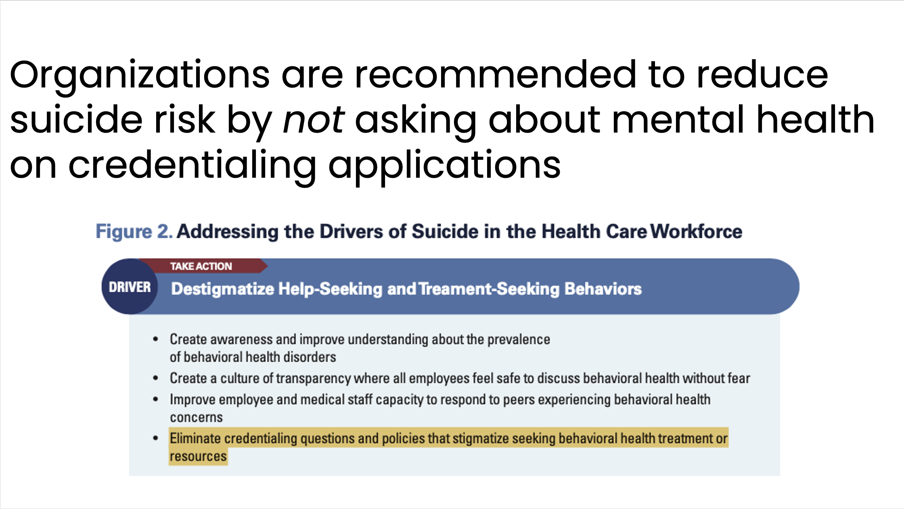
Notes:
In this report they recommend addressing the drivers of suicide in the health care workforce. A specific recommendation is to destigmatize help-seeking and treatment-seeking behaviors.
Additionally, when listing steps to address the drivers of suicide in the health care workforce, they specifically recommend organizations “eliminate credentialing questions and policies that stigmatize seeking behavioral treatment or resources”

Slide 18
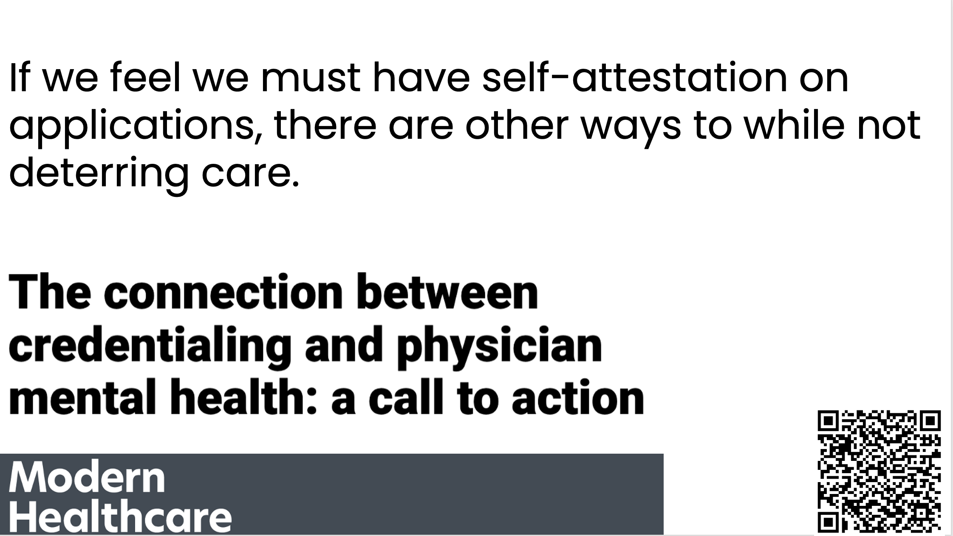
Notes:
If you’re wondering what to do to reduce stigma and reduce barriers to physicians seeking mental health care, there is guidance available.
First, we can opt to stop asking these questions! Many states and credentialing applications are choosing this.
But if for some reason we’re not ready to do that you can ask different questions, and lend support, as is recommended in this article from Modern Healthcare

Slide 19
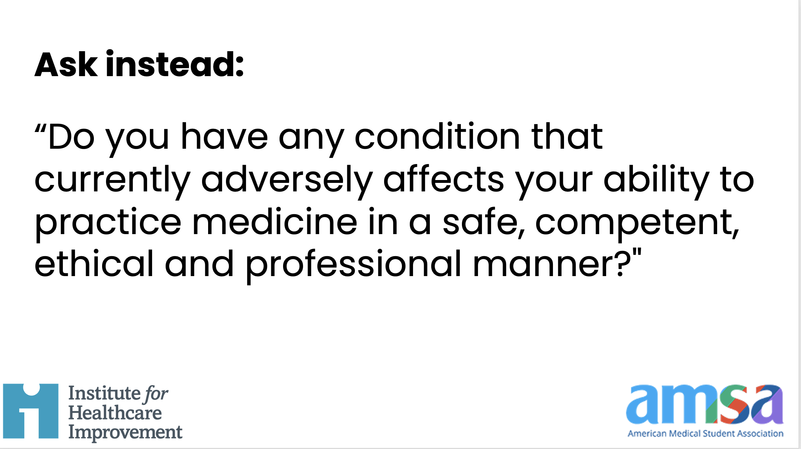
Notes:
You can change the questions on your application to no longer ask about receiving mental health care or having a diagnosis, and instead ask this: “Do you have any condition that currently adversely affects your ability to practice medicine in a safe, competent, ethical and professional manner?"

Slide 20
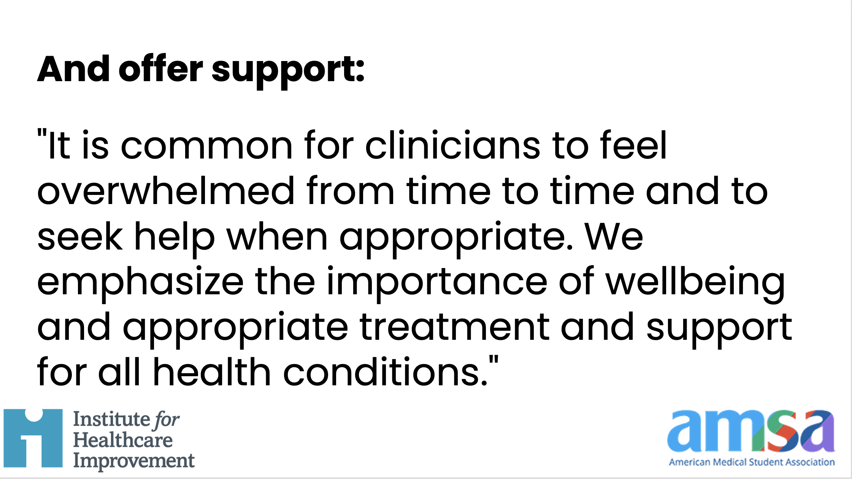
Notes:
It is also good to offer a supportive statement, such as this one: “It is common for clinicians to feel overwhelmed from time to time and to seek help when appropriate. We emphasize the importance of wellbeing and appropriate treatment and support for all health conditions."

Slide 21
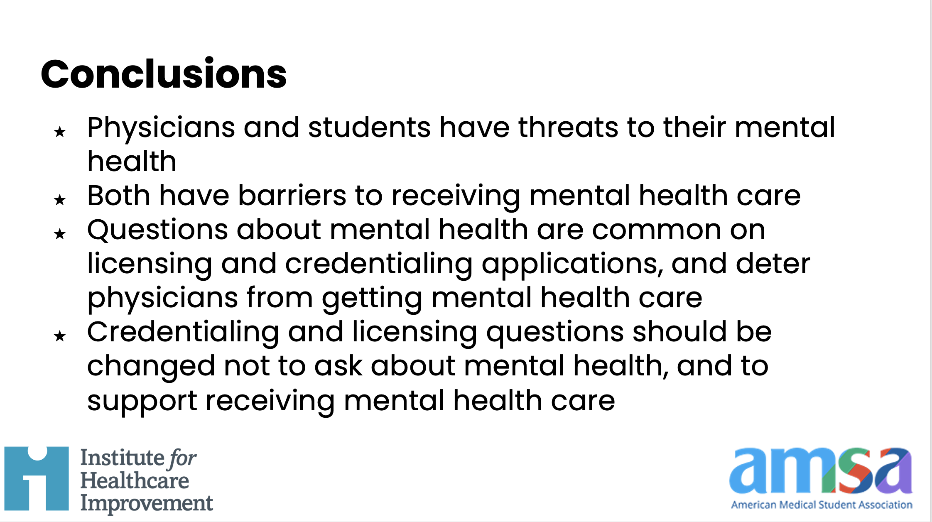
Notes:
Now that we’ve reviewed stories and articles, barriers, and solutions, here are conclusions.
(Speaker can choose to read the steps listed)

Slide 22
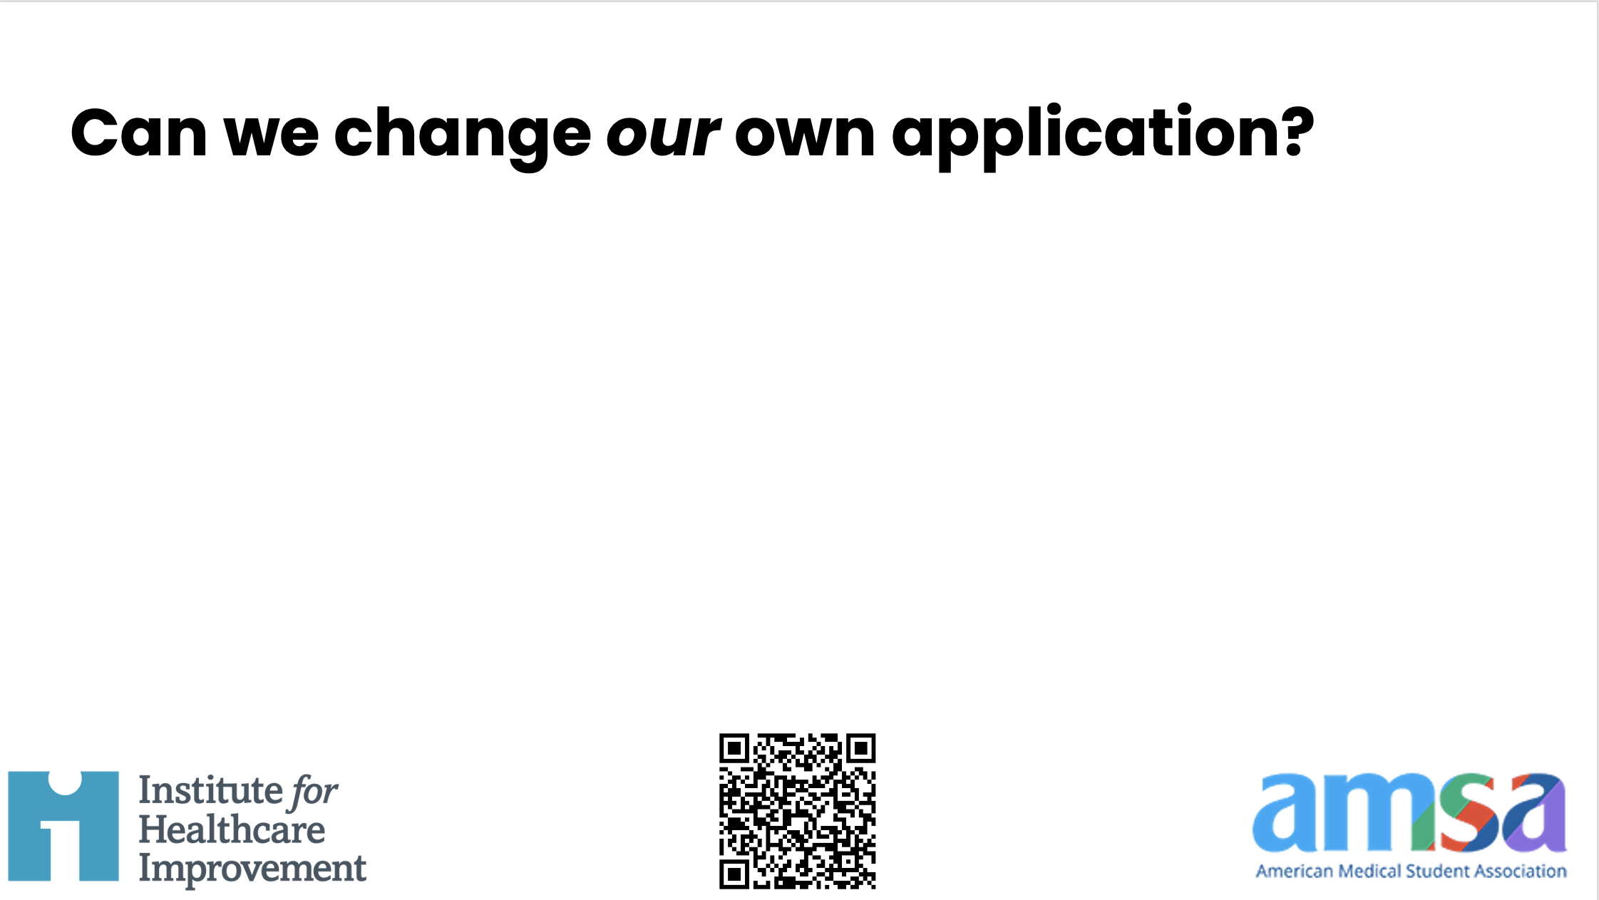
Notes:
Now that we’ve reviewed stories and articles, barriers, and solutions, I’d like us right now to consider:
Can we change our own application to be in line with these expert recommendations?
I hope that we can, and if you can’t make decide today then please point your smartphone camera to this QR code for more resources on this topic.

